Slide 1
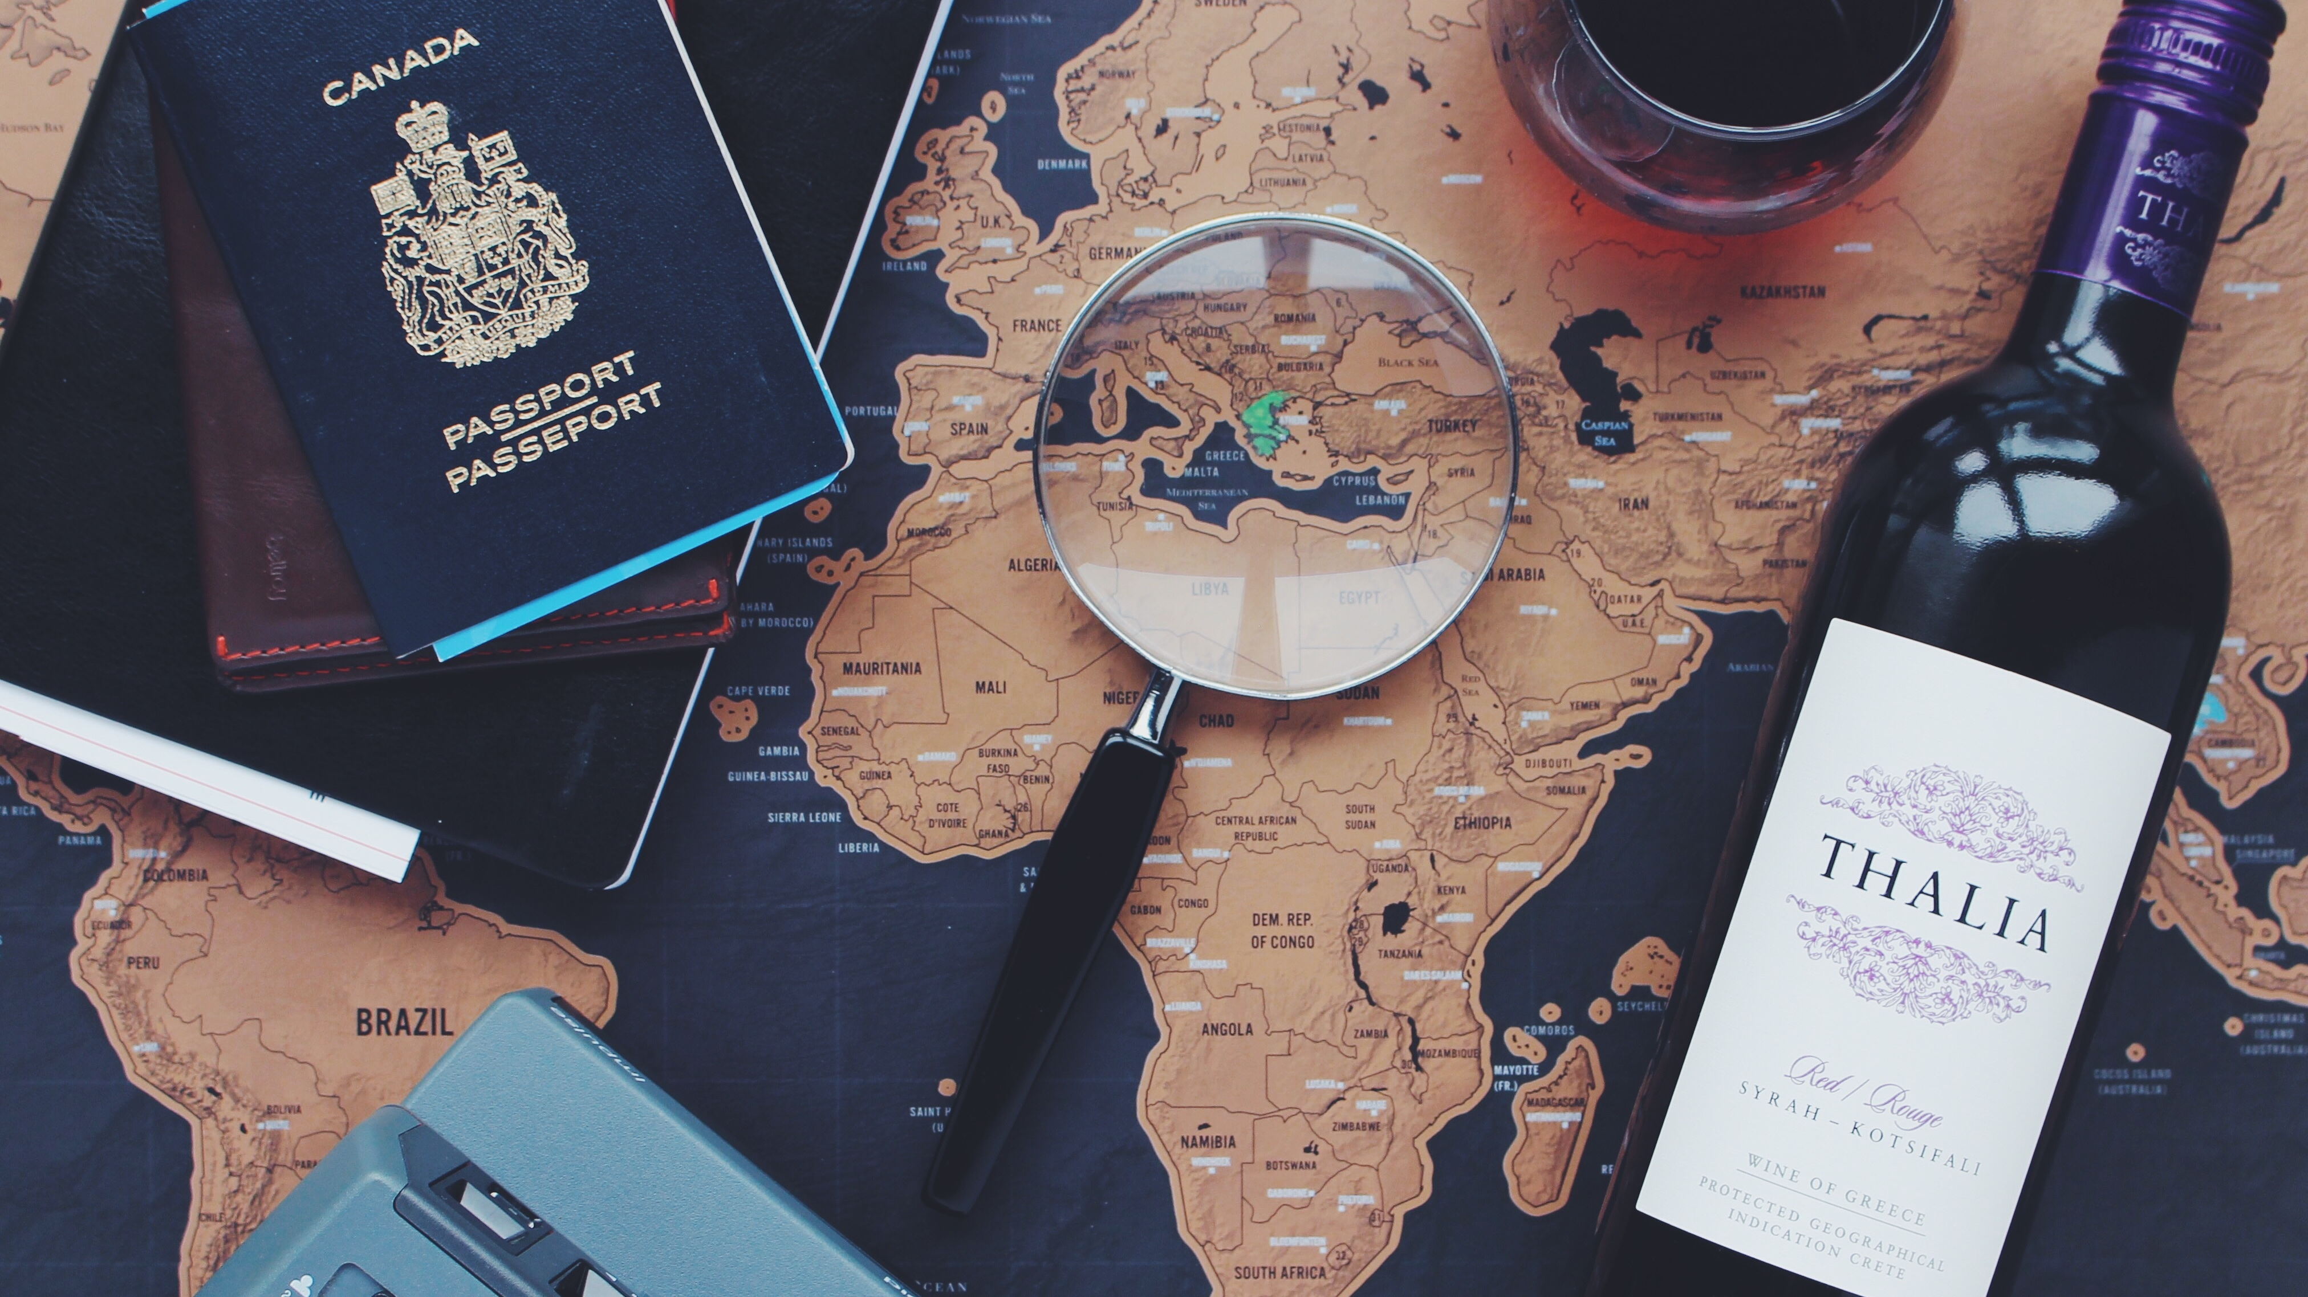
पर्यटनम् - to know, to explore, to learn!
PRESENTED BY :
Nusrat Sakharkar

Slide 2

OBJECTIVES OF OUR PROJECT :
1) To study travel related behavior of individuals with respect to different factors.
2) To study the most convenient mode of travel.
3) To study the percentage of preparations an individual invests on a single tour.
4) To study the activities an individual likes to do while travelling.
5) To study the mindset of an individual with which they make the choice of travel destination.
( Eg: religious, adventurous, etc. )

Slide 3
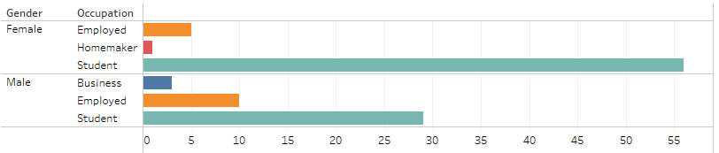
OVERVIEW OF THE DATA COLLECTED :
Data collected by circulating Questionnaire
Total number of observations collected : 111
Number of observations after cleaning : 104

Slide 4
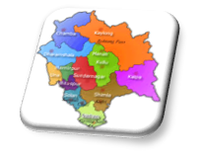
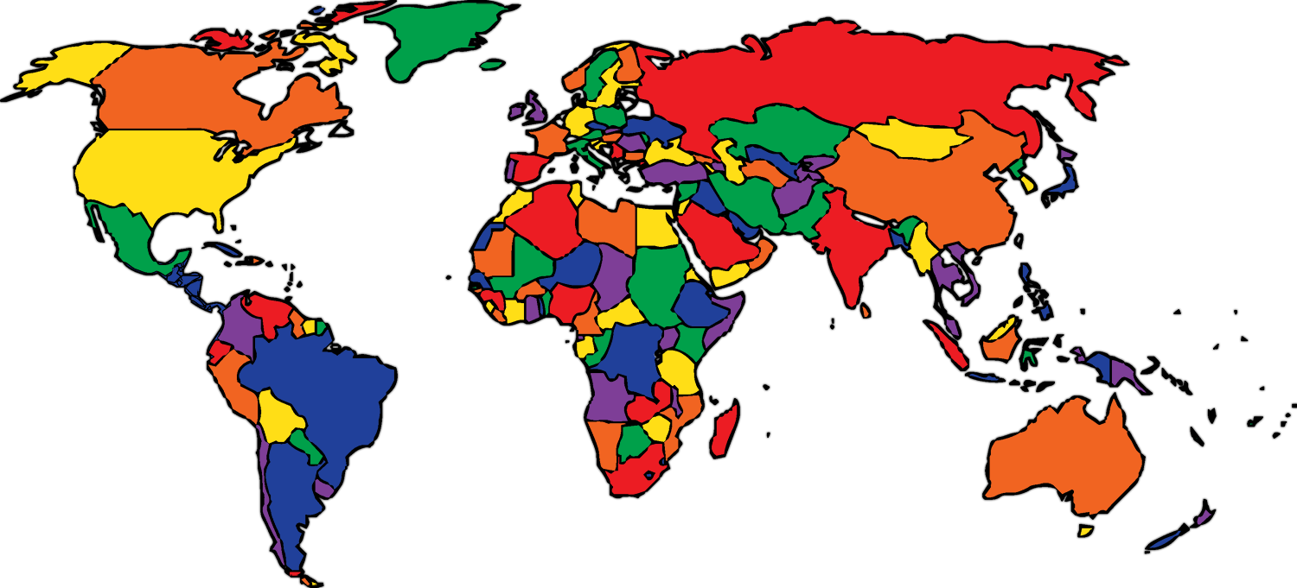

Slide 5
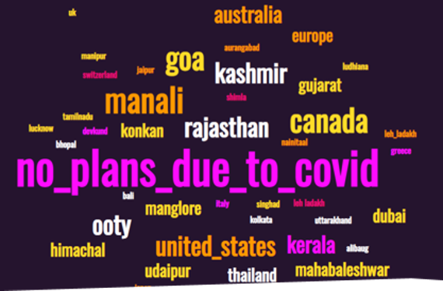
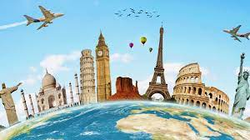

WHAT WILL BE YOUR NEXT DESTINATION?

Slide 6

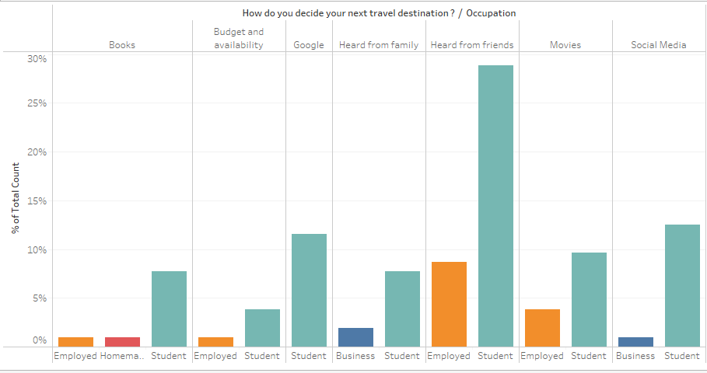
How do you decide your next travel destination?

Slide 7
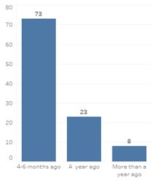
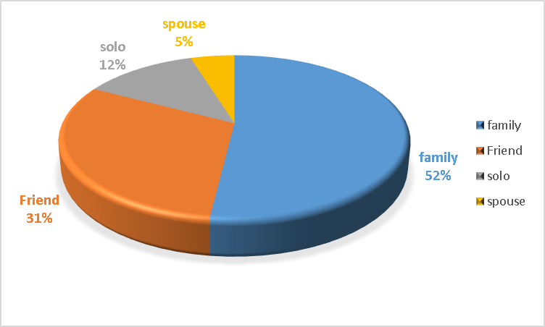
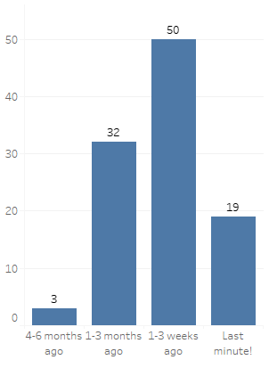
How well in advance do you start preparing for your trip?
With whom do you travel the most?
Domestic trip
International trip

Slide 8
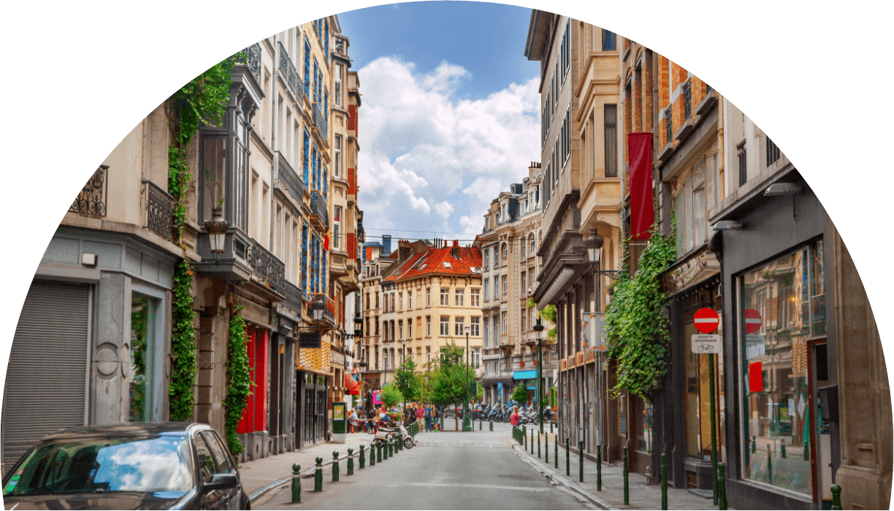
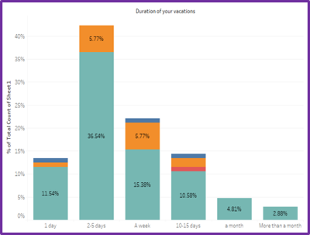
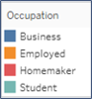
What is mostly the duration of your vacation?

Slide 9
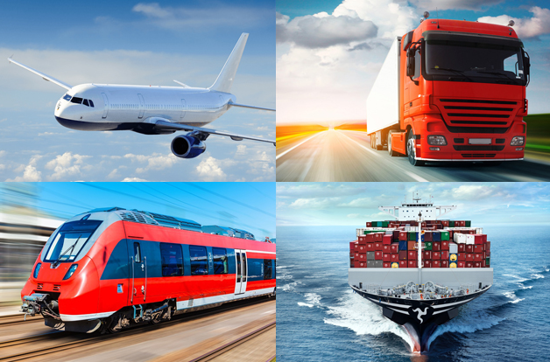
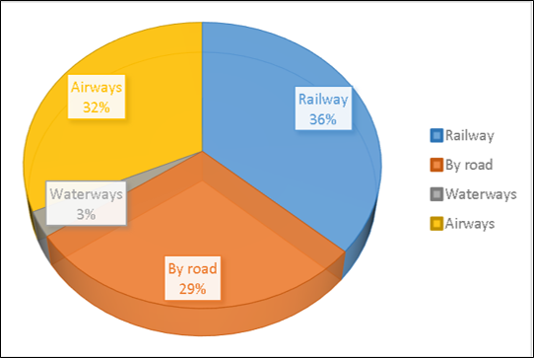
Which mode of transport do you prefer when travelling within the country?

Slide 10
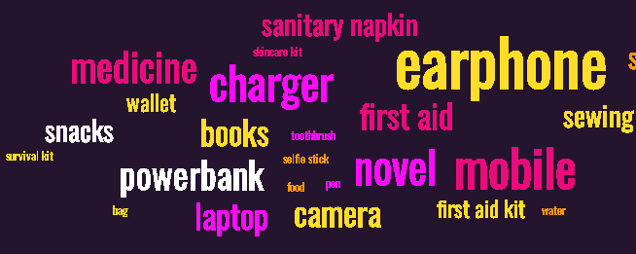
What are your travelling essentials?

Slide 11
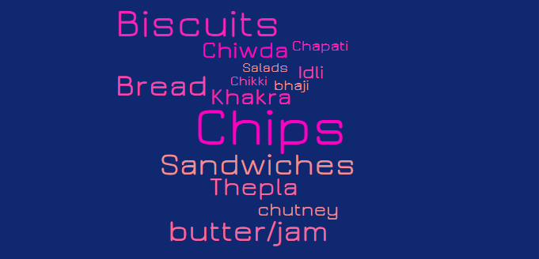
What food do you carry when travelling?

Slide 12
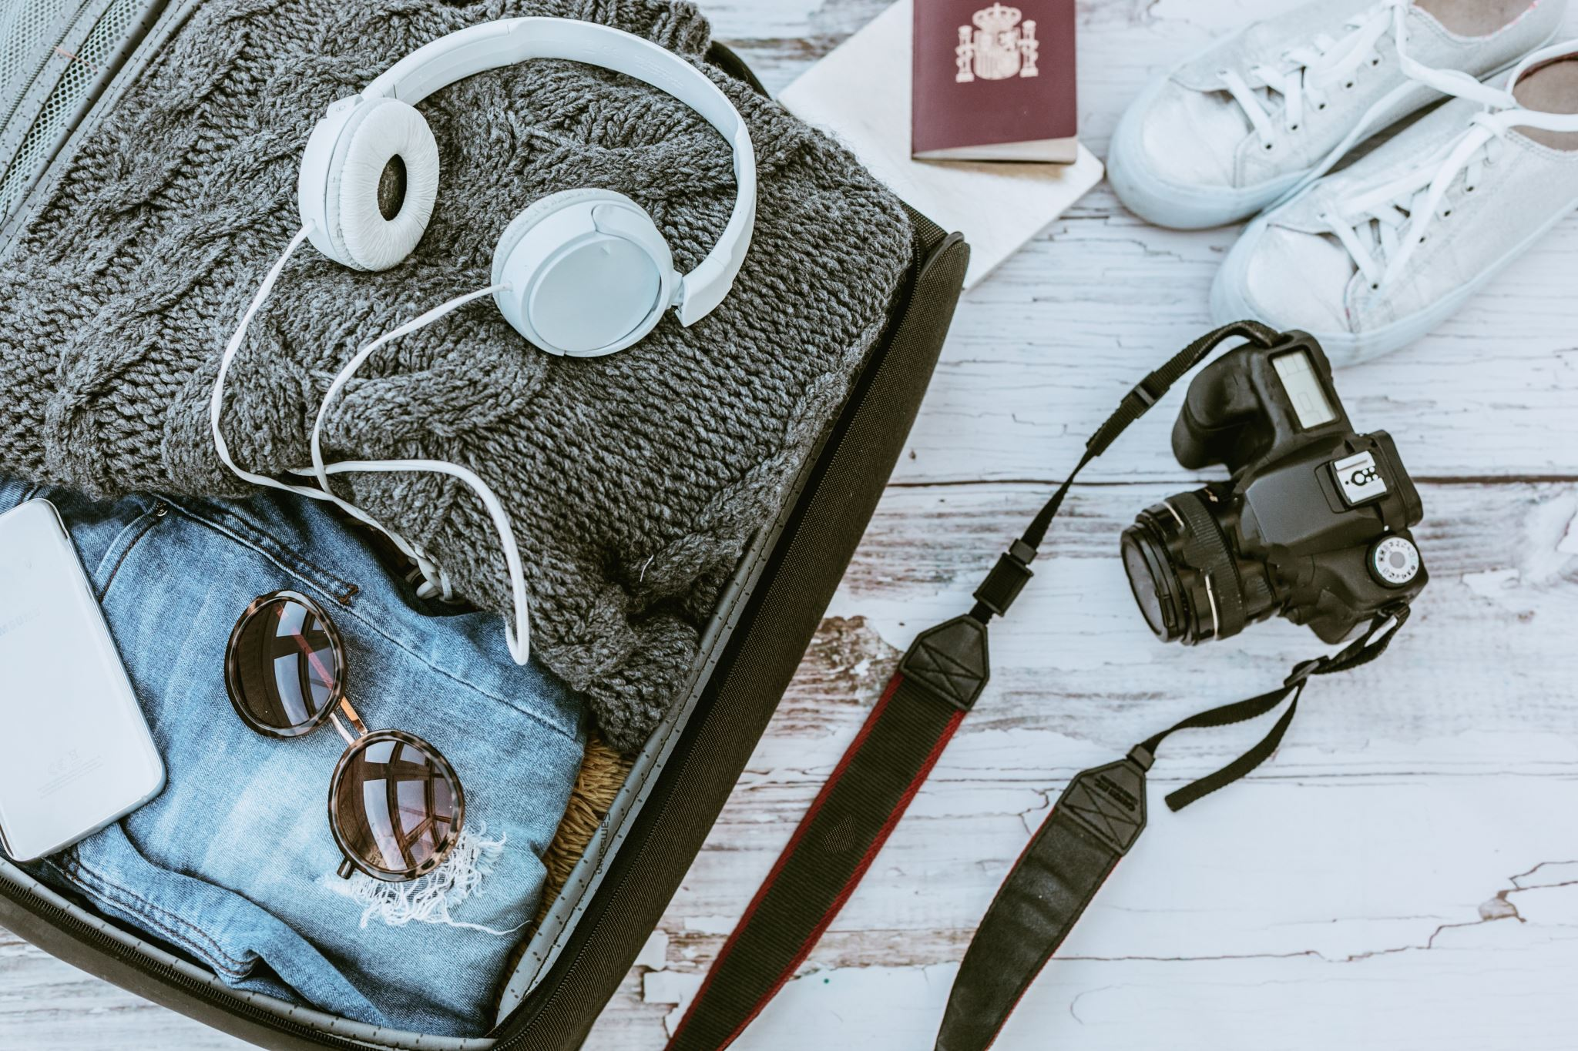
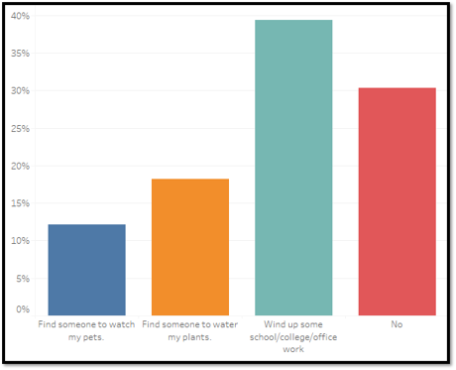
Are there any loose ends that you need to tie up before travelling?

Slide 13

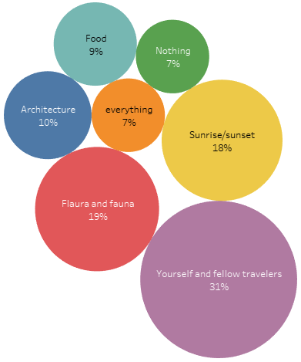
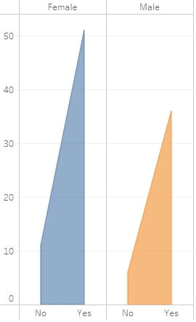
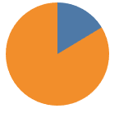
Travelling and technology
Do you try to use your phone or other technology less when you are on a vacation?
What do you mostly take photos of when travelling?
Would you learn another language to feel more comfortable on your travel?
No
16%
Yes
84%

Slide 14
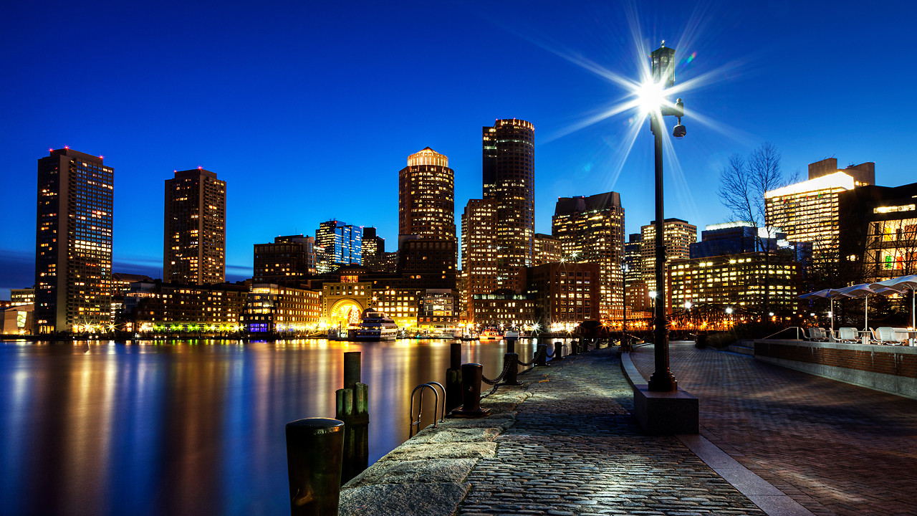
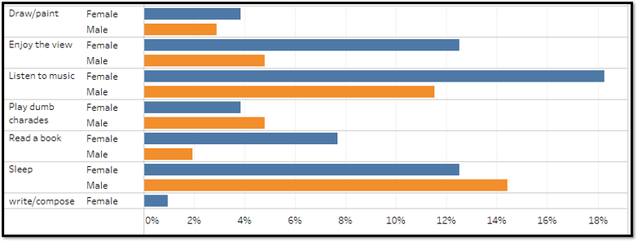
What do you do while travelling?

Slide 15
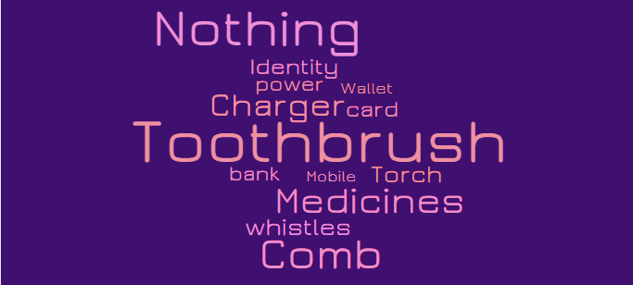
What have you forgotten to take on a trip?

Slide 16
Rapid fire – travel edition!

Slide 17
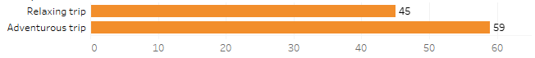
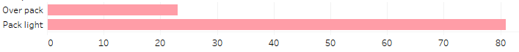

Slide 18
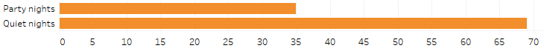

Slide 19
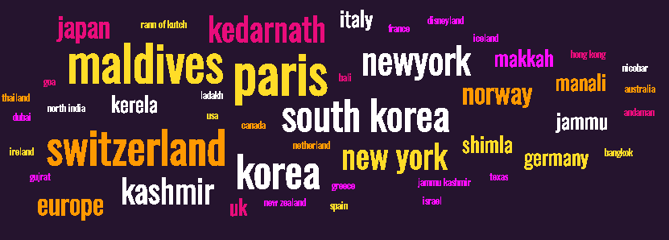
What is your dream travel destination?

Slide 20

Now most people don’t have travel plans due to the pandemic.
Next travel destinations are mostly influenced by friends while
majority of people like travelling with their family members.
2 to 5 days is the most preferred vacation duration.
For a domestic trip, railways is the most preferred mode of travel.
Most people try to reduce usage of technology when they are on a trip.
People prefer learning a new language to feel more comfortable on their trip.
Most women listen to music while traveling whereas most men sleep on their journeys.

Slide 21

Software Used
Python
Excel
Tableau
“Live life with no excuses, travel with no regret”

